Slide 1
Zomato Delivery Analysis
By: Aman & Harshit

Slide 2
01
02
03
04
Rider Workload Analysis
Factors Affecting Delivery Time
WHAT WE COVERED IN THIS ANALYSIS
KPI’s
Conclusion
KPI (Key Performance Indicator) measures success, efficiency, and goal achievement in business operations
Rider Workload Analysis examines delivery counts, efficiency, and rider distribution impact.
Traffic, rider efficiency, and city type impact Zomato delivery time insights.
Summary of whole of Zomato Analysis.

Slide 3
ZOMATO DELIVERY PERFORMANCE ANALYSIS
Overview Of Analysis:
Total Deliveries – Understanding delivery volume and efficiency
Average Time Taken – Measuring speed and operational
Average Rating – Assessing customer satisfaction levels
Rider Distribution – Evaluating workforce efficiency
Notes:
Thank you Harshit .
We will uncover the key insights which helps improving Zomato delivery in food industry.
Let me move forward with explaining some important KPIs such as.

Slide 4

SUMMARY OF DELIVERY PERFORMANCE
OUR KPI’S
Total Deliveries: 46K – A high volume, indicating strong operational capacity. Avg. Time Taken: 26 minutes – Reflecting delivery efficiency across locations. Average Rating: 4.6 – Suggesting high customer satisfaction and service quality. Total No of Riders: 1.3K – Showing a well-distributed workforce. Success Rate: 70.16% – A positive indicator of overall delivery efficiency
Notes:
Total no of deliveries = it shows how many orders are delivered
avg time taken = it shows avg time of delivery
avg rating = avg ratings of delivery person which is given by customers as per their delivery satisfaction level
total no of riders = it showing how many delivery partners we have
success rate = it means whether the order is delivered within 30 min or not so as per our analysis success rate in metropolitan cities where order is delivered within 30 min is 70.16 %
Now over to Harshit .

Slide 5
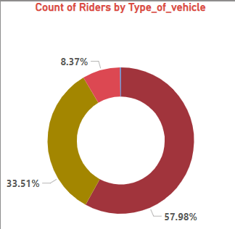
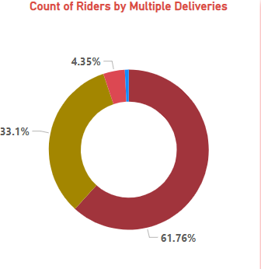
RIDER WORKLOAD ANALYSIS
Rider Efficiency: Examining the effect of delivery counts on rider workload and performance.
Multiple vs. Single Delivery Distribution: Riders dealing with multiple deliveries at a time compared to single deliveries.
Time Management: Pin pointing delays resulting from heavy workloads or less efficient routes.

Slide 6
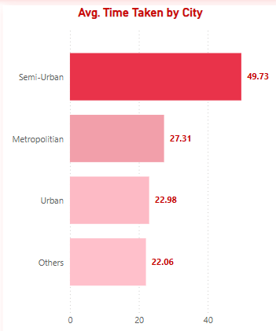
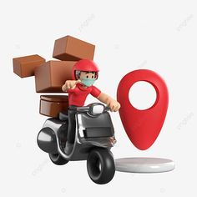
Factors Affecting Delivery Time
Delivery durations differ depending on traffic, rider performance, and city type. Heavy congestion creates delays, whereas skilled riders operate efficiently. City centers guarantee faster deliveries, but semi-urban areas experience infrastructural challenges. Maximizing these factors maximizes efficiency and customer satisfaction.
Notes:
As I have explained as above the avg time taken in this Zomato delivery analysis is approx. 26 min now we will uncover the no of factors affecting delivery time
Where delivery duration depends on traffic which means time taken on heavy/normal/jam and medium routes another impacting factor is the rider performance as per the city types
Heavy congestion creates delays where as kill riders operate efficiency
In City centers/metro city are faster deliveries as comparing to sub urban as you know metro cities are more developed in infrastructure.

Slide 7
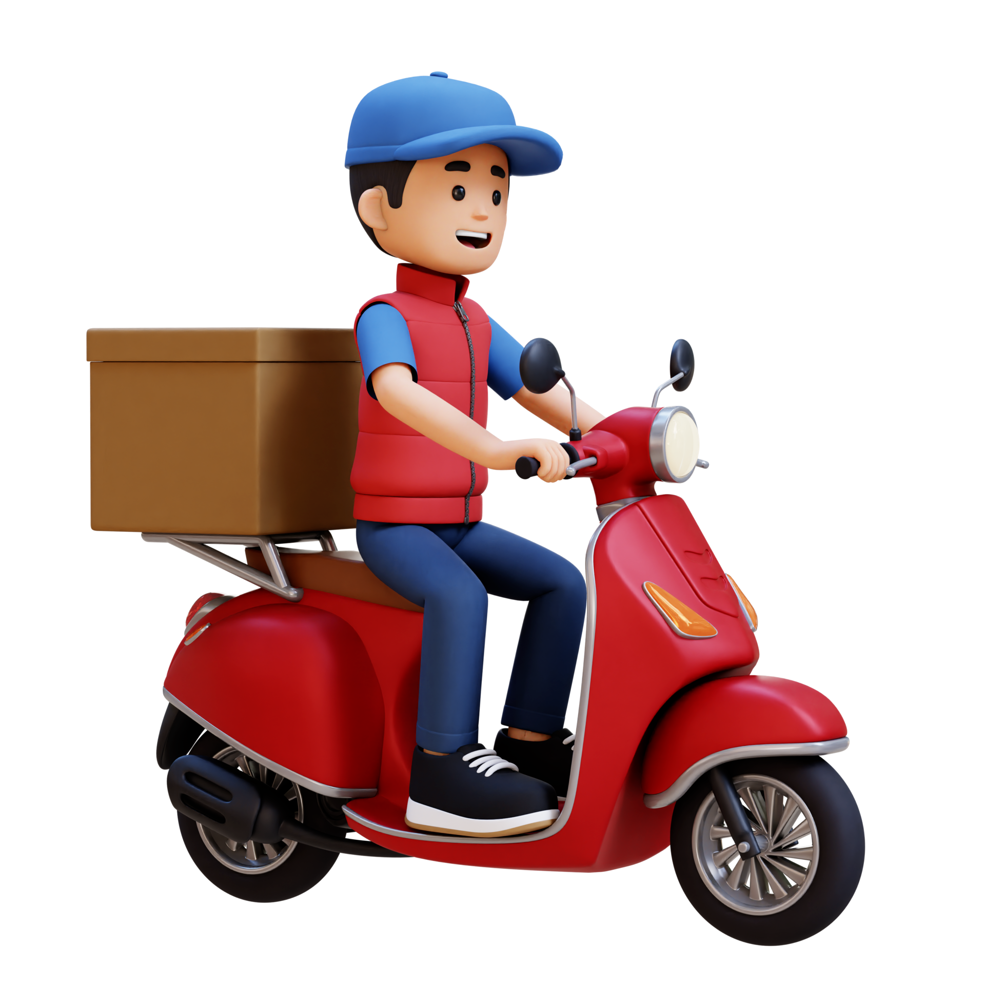

Power BI Desktop
ZOMATO DELIVERY DASHBOARD
Total Deliveries
46K
Avg. Time Taken
26.29
Average Rating
4.6
Total No. Of Riders
1.32K
V
V
Never have a bad meal
Apr
Feb
Mar
bicycle
electric_scooter
motorcycle
>
Success Rate
Avg. Time Taken by Riders
Avg. Time Taken by City
ALHRES12DE…
70.16
KOLRES19DE…
Semi-Urban
49.73
0.00 100.00
Traffic Impact on Avg. Delivery Time
AGRRES17DE…
KNPRES14DE…
Metropolitian
27.31
Low 16%
GOARES08D…
Jam 23.45%
ALHRES010D…
KOLRES03DE…
Urban
22.98
Unknown 19.97%
ALHRES18DE…
KNPRES06DE…
Others
22.06
High 20.49%
DEHRES09DE…
Medium 20.09%
0
20
40
0
20
40

Slide 8
ZOMATO DELIVERY DASHBOARD
Power BI Desktop
Total Deliveries
46K
Avg. Time Taken
26.29
Average Rating
4.6
Total No. of Riders
1.32K
Never have a bad meal
Select all
Buffet
Drinks
Meal
Snack
Avg. Time Taken by Month
Count of Riders by Type_of_vehicle
Count of Riders by Multiple Deliveries
26.5
26.53
8.37%
4.35%
26.4
33.1%
26.3
26.28
33.51%
26.2
57.98%
61.76%
26.12
26.1
February
March
April
motorcycle
scooter
electric_scooter
bicycle
1 0 2 3
Notes:
In this dashboard we have one line chart and two donut charts line chart basically showed avg time by month .(may be in particular month has festival so we have maximum orders)
The line charts shows avg delivery time month by month as you can see delivery time is decreasing
first donut chart break down riders by vehicle 58% use motorcycle , 33% scooter 8.3 % electric scoters and the rest of use bicycles or other vehicles
the second donut chart highlights delivery frequency 61.67% of riders manage 1-2 deliveries while 33.1% do 2-3 deliveries and
4.3% handle over 3 , this showing workload situation.
Now over to harshit

Slide 9


Slide 10
BIKE & SCOOTER
BICYCLE
Scooters provide quicker deliveries, improving efficiency, but increase fuel costs and environmental impact over time significantly.
Cycles are eco-friendly and cost-effective but slower, potentially affecting customer satisfaction and overall delivery service efficiency.
The Zomato delivery dataset with real-time traffic data and customer feedback can improve insights. This will help identify delay causes, optimize routes, and boost operational efficiency for better service delivery.

Slide 11
By looking at delays in cities, multiple deliveries, and order types, we can find ways to do better.
Point 1
Point 2
Optimize city routes and minimize multiple deliveries
Keep popular items ready for faster delivery.
Notes:
This slide highlights two key takeaways from the Zomato delivery analysis .
First optimizing city route can reduce delays in multiple deliveries
Second keeping popular items ready speeds up delivery times.
By focusing on delays , cities , order type , we can improve efficiency and customer satisfaction.

Slide 12
Integrating predictive weather models and driver performance metrics will further refine the dataset.
These improvements enable proactive decision-making, reduce delivery times, and elevate customer satisfaction, ultimately strengthening Zomato’s competitive edge in the market.
Notes:
This slide suggests that using predictive weather models and driver performance metrics can improve Zomato's delivery performance
These enhancements allow for better:
decision-making,
faster deliveries
and higher customer satisfaction
giving Zomato a stronger competitive advantage in the market by addressing key operational challenges effectively.

Slide 13
Thanks!
Please keep this slide for attribution.

